Slide 1
Deep Learning Minor
Using pre-trained Model
Lecturer: Youssef Ennali
prepared by:
Marya Butt, PhD.

Slide 2
Using Pretrained Model
A pretrained model is a model that was previously trained on a large dataset, typically on a large-scale image-classification task.
If this original dataset is large enough and general enough, the spatial hierarchy of features learned by the pretrained model can effectively act as a generic model of the visual world, and
hence, its features can prove useful for many different computer vision problems, even though these new problems may involve completely different classes than those of the original task.

Slide 3
Using Pretrained Model
There are 2 ways to use a pretrained model
feature extraction
(not changing the weights)
fine-tuning
(tune some weights in the last layers to learn a similar task)

Slide 4
Using Pretrained models (for classification problem)
ImageNet dataset:
(1.4 million labeled images and 1,000 different classes)
Description: ImageNet contains many animal classes, including different species of cats and dogs, and you can thus expect it to perform well on the dogs-versus-cats classification problem.
Pre-trained models:
VGG, ResNet, Inception, Xception

Slide 5
Using Pretrained models (for object detection)
1) COCO dataset
MS COCO dataset is a large-scale object detection, segmentation, and captioning dataset published by Microsoft. The large dataset comprises annotated photos of everyday scenes of common objects.
'person', 'bicycle', 'car', 'motorcycle', 'airplane', 'bus', 'train', 'truck', 'boat', 'traffic light', 'fire hydrant', 'stop sign', 'parking meter', 'bench', 'bird', 'cat', 'dog', 'horse', 'sheep', 'cow', 'elephant', 'bear', 'zebra', 'giraffe', 'backpack', 'umbrella', 'handbag', 'tie', 'suitcase', 'frisbee', 'skis','snowboard', 'sports ball', 'kite', 'baseball bat', 'baseball glove', 'skateboard', 'surfboard', 'tennis racket', 'bottle', 'wine glass', 'cup', 'fork', 'knife', 'spoon', 'bowl', 'banana', 'apple', 'sandwich', 'orange', 'broccoli', 'carrot', 'hot dog', 'pizza', 'donut', 'cake', 'chair', 'couch', 'potted plant', 'bed', 'dining table', 'toilet', 'tv', 'laptop', 'mouse', 'remote', 'keyboard', 'cell phone', 'microwave', 'oven', 'toaster', 'sink', 'refrigerator', 'book', 'clock', 'vase', 'scissors', 'teddy bear', 'hair drier', 'toothbrush’
2) Pretrained models
RCNN
Faster RCNN
YOLO

Slide 6
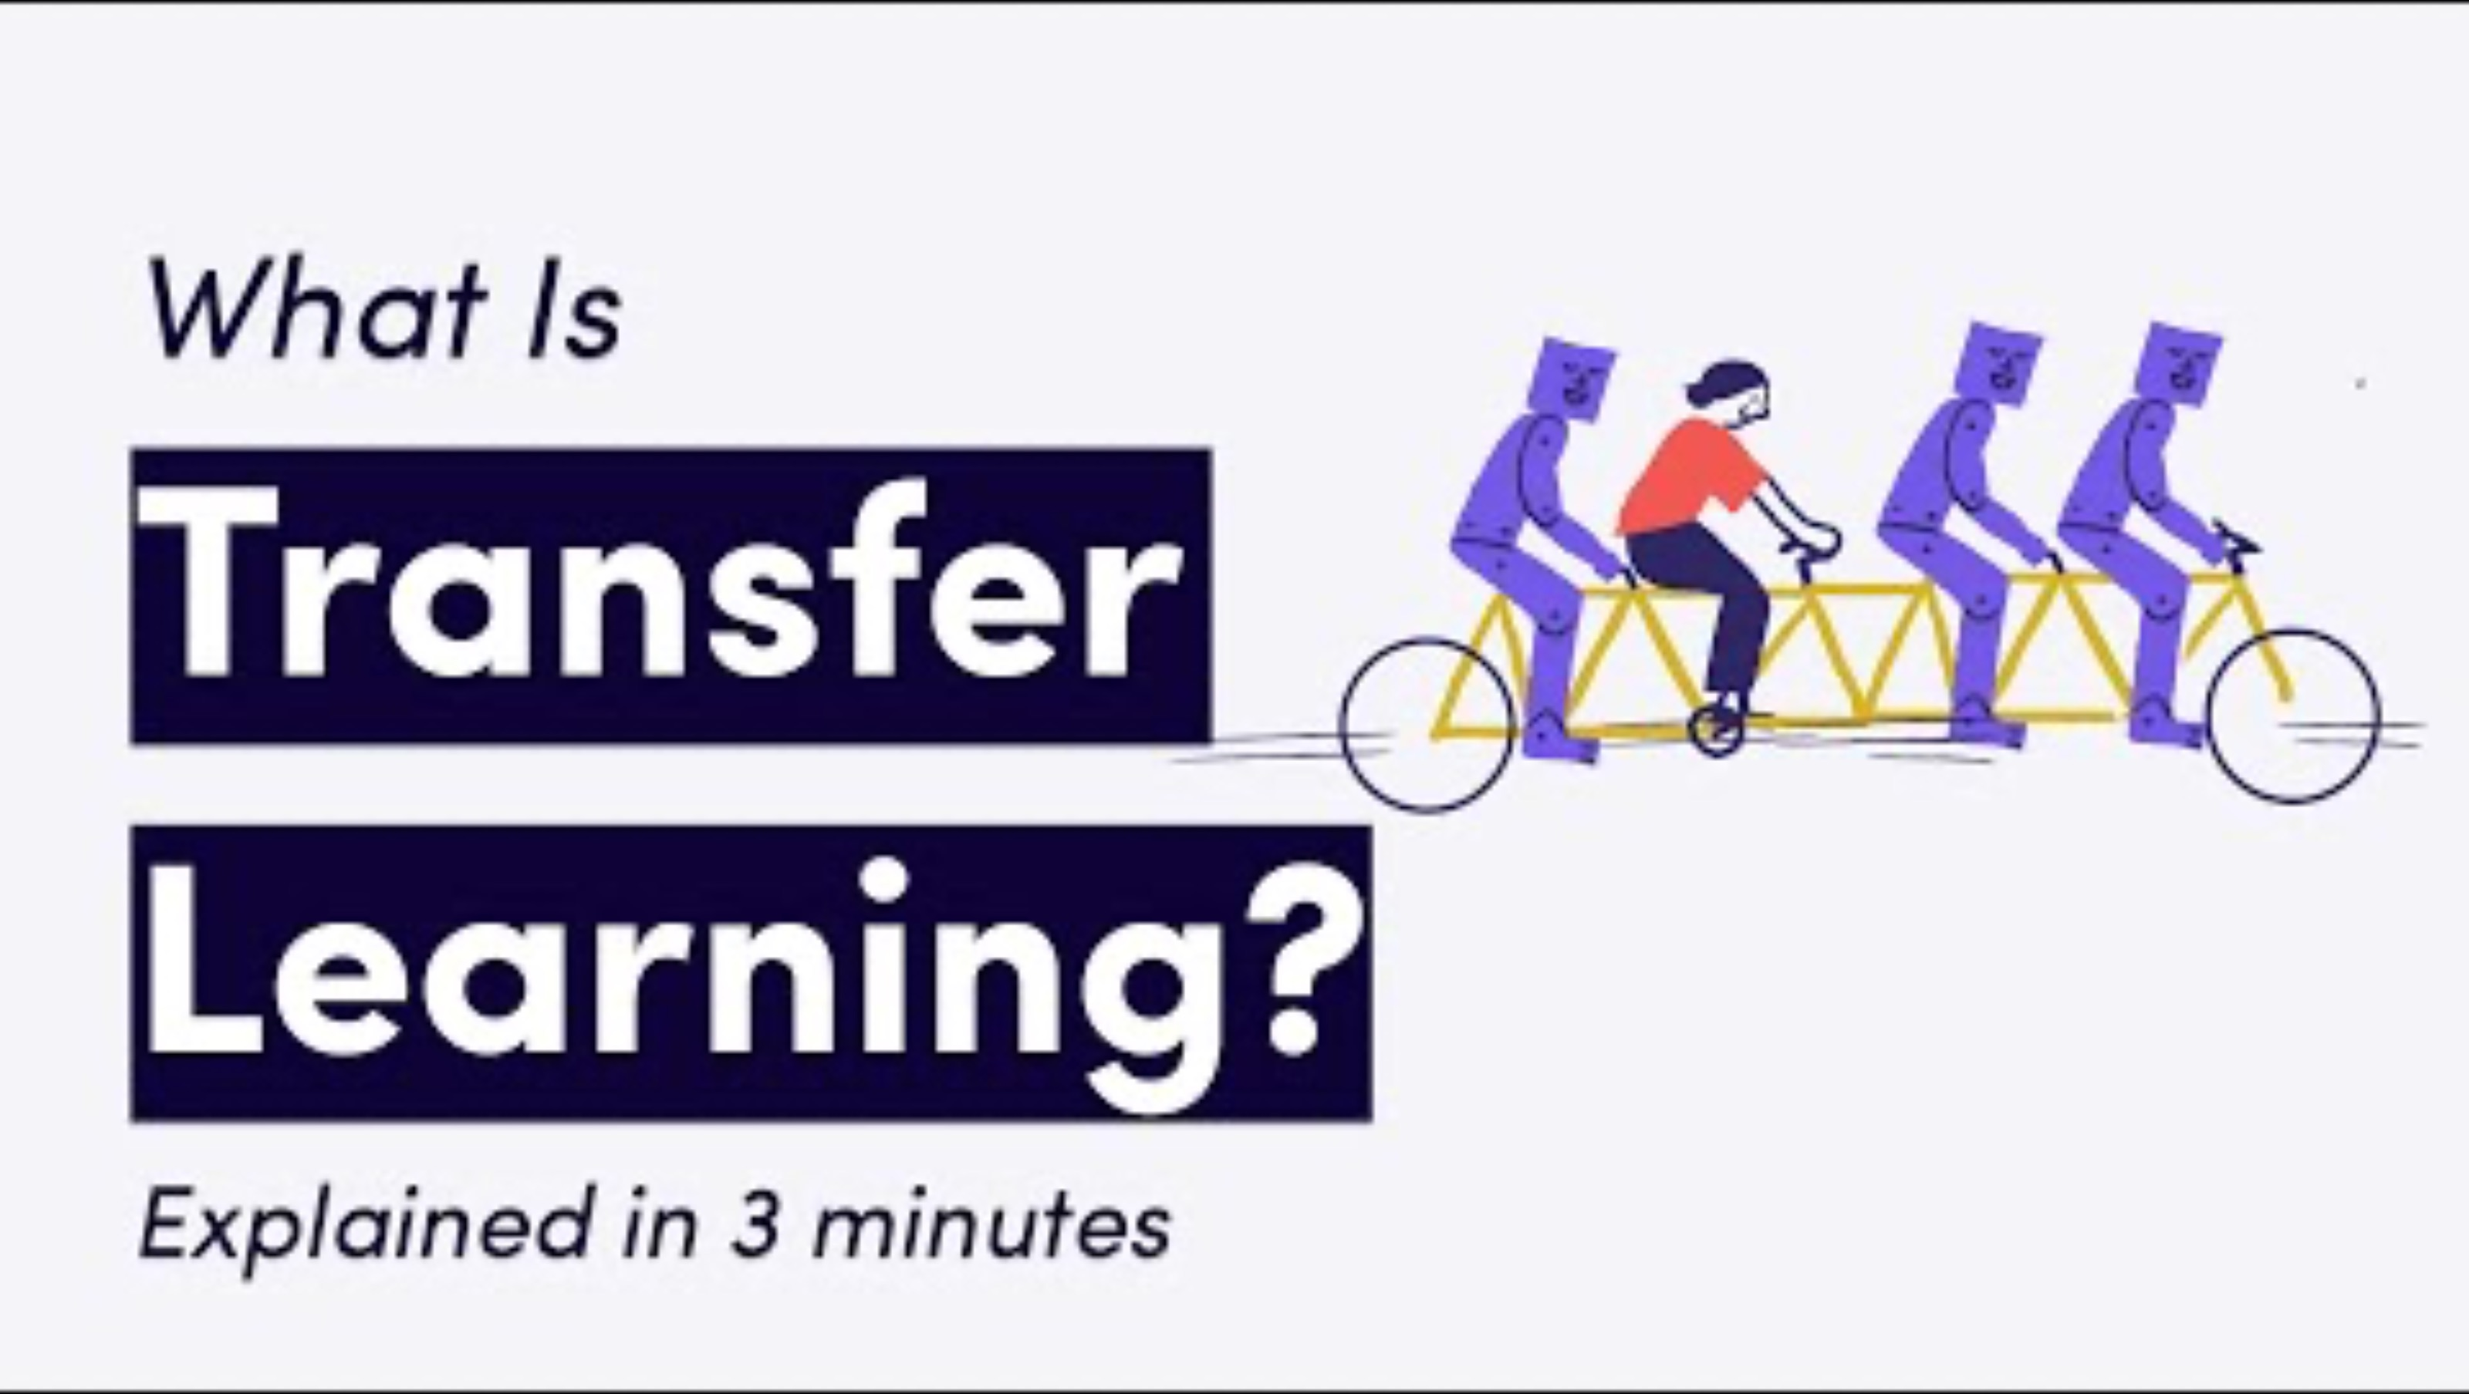
Transfer Learning
A short explanation:

Slide 7
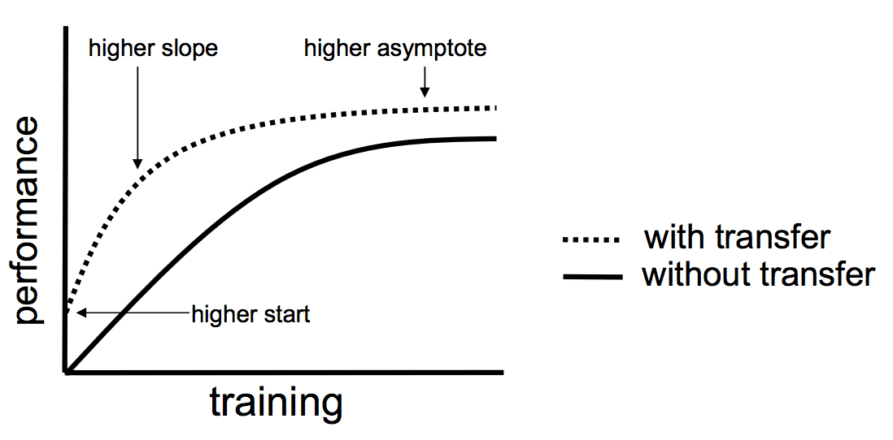
Transfer Learning
Transfer learning is a machine learning method where a model developed for a task is reused as the starting point for a model on a second task.
Higher start: The initial skill (before refining the model) on the source model is higher than it otherwise would be.
Higher slope: The rate of improvement of skill during training of the source model is steeper than it otherwise would be.
Higher asymptote: The converged skill of the trained model is better than it otherwise would be.

Slide 8
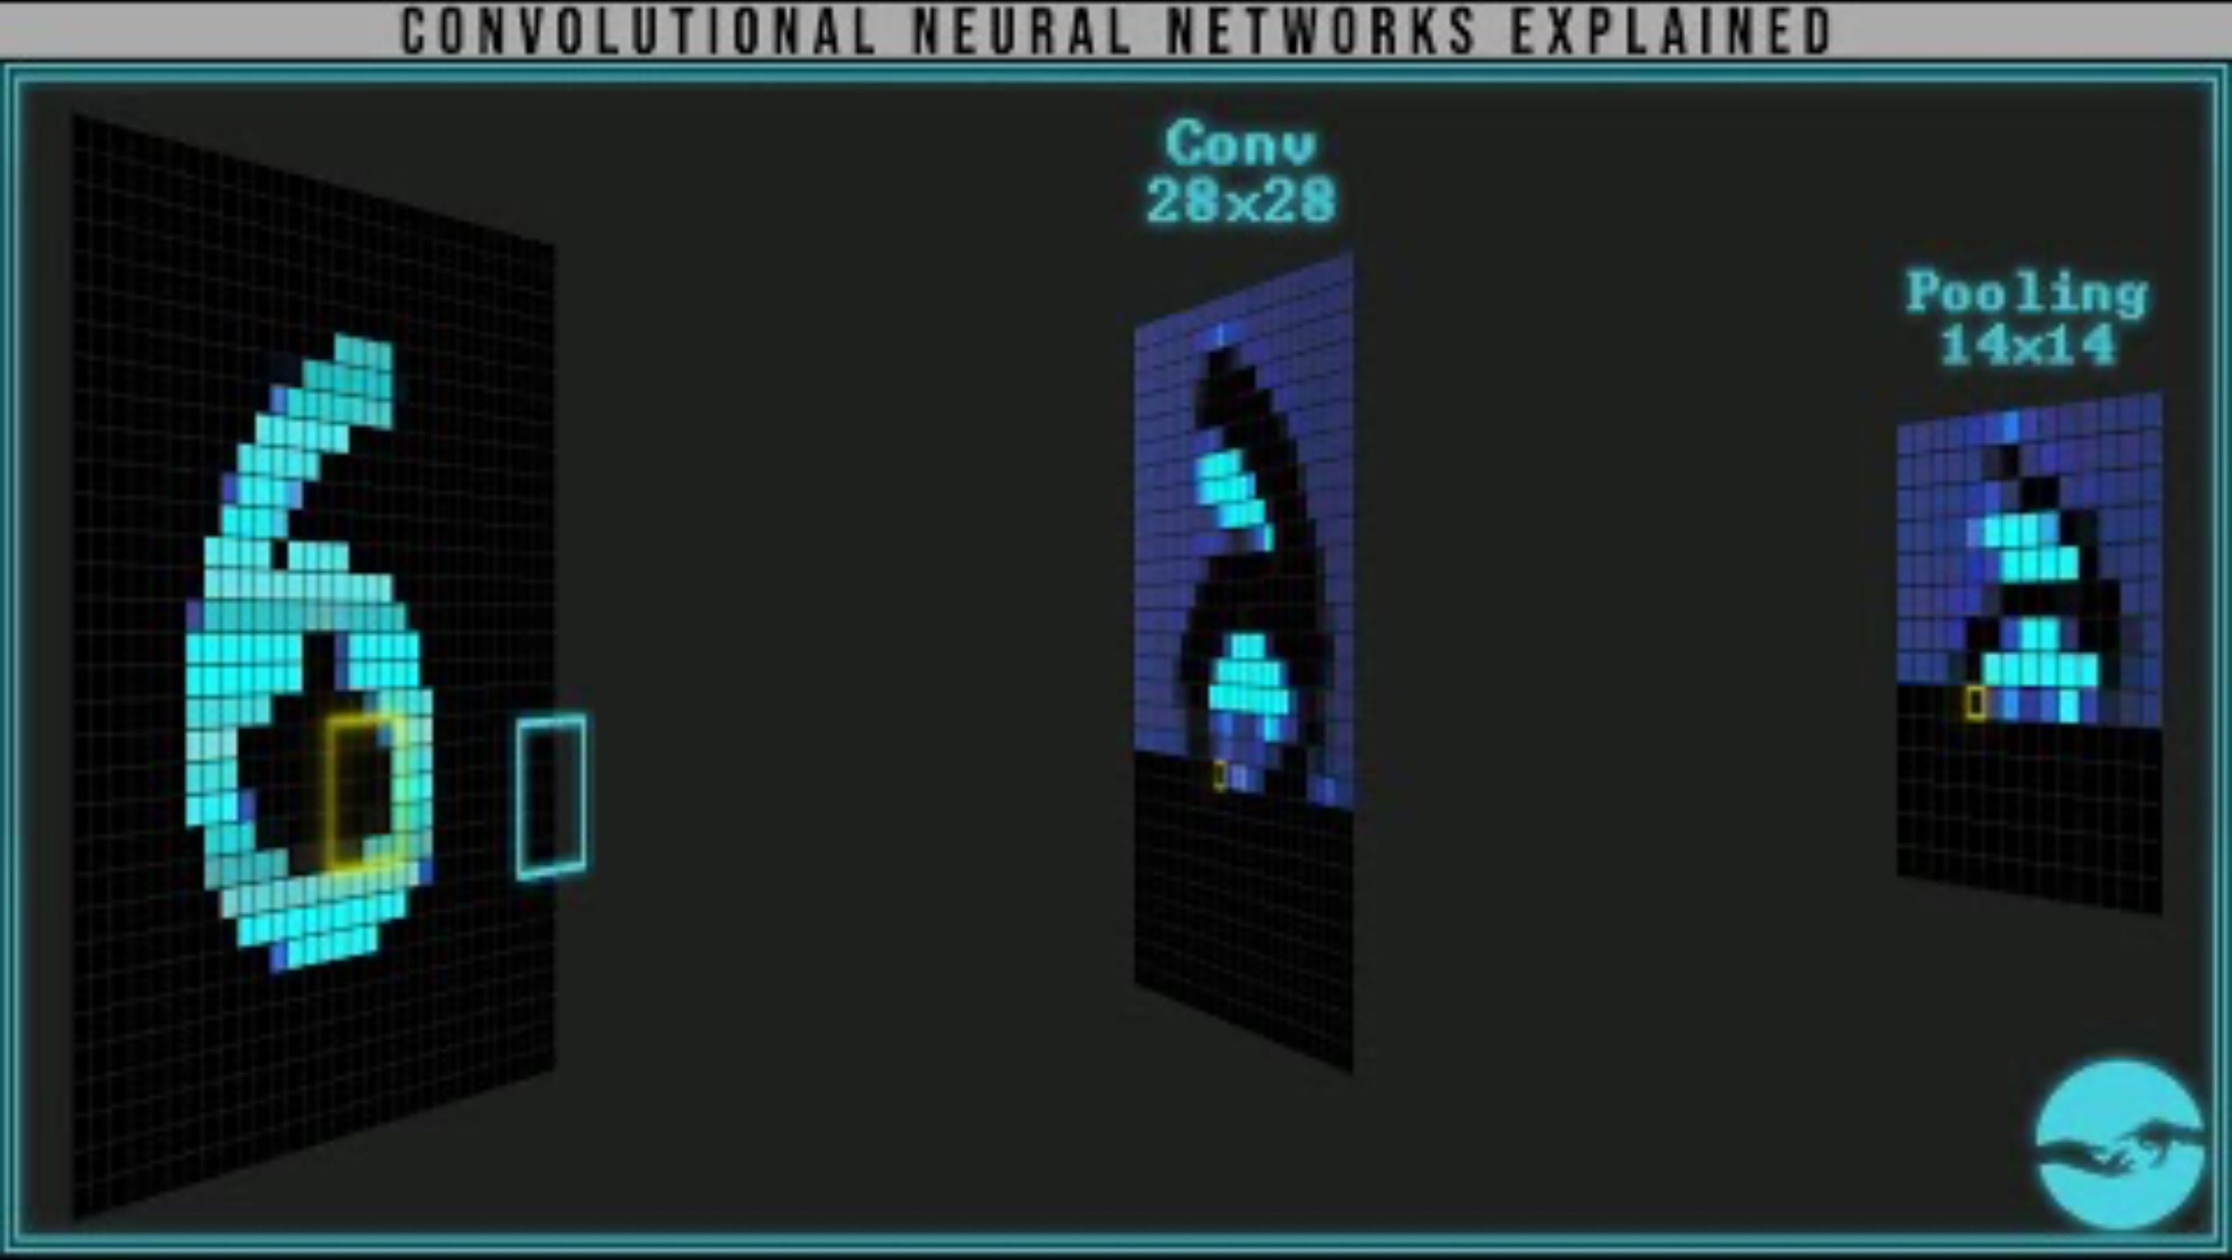
Convolutional Neural Networks
Was this already explained?

Slide 9
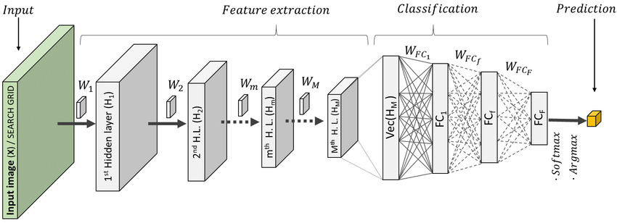
Feature Extraction and Classifier
Convnets used for image classification comprise two parts:
start with a series of pooling and convolution layers
end with a densely connected classifier
The first part is called the convolutional base of the model

Slide 10
Using Pretrained model (Feature Extraction)
Import pretrained model
You can import it from the keras.applications module. Many other
image-classification models (all pretrained on the ImageNet dataset) are available as part of keras.applications:
Xception
ResNet
MobileNet
EfficientNet
DenseNet
Lets import VGG16 pretrained model
from keras.applications.vgg16 import VGG16

Slide 11
Using Pretrained model (Feature Extraction)
Instantiating the VGG16 convolutional base
conv_base = keras.applications.vgg16.VGG16(
weights="imagenet",
include_top=False,
input_shape=(180, 180, 3))
weights specifies the weight checkpoint from which to initialize the model.
include_top refers to including (or not) the densely connected classifier on top of the network.
input_shape is the shape of the image tensors that we’ll feed to the network.

Slide 12
Using Pretrained model (Feature Extraction)
>>> conv_base.summary()
Model: "vgg16"
_________________________________________________________________
Layer (type) Output Shape Param #
================================================
input_19 (InputLayer) [(None, 180, 180, 3)] 0
_________________________________________________________________
block1_conv1 (Conv2D) (None, 180, 180, 64) 1792
_________________________________________________________________
block1_conv2 (Conv2D) (None, 180, 180, 64) 36928
_________________________________________________________________
block1_pool (MaxPooling2D) (None, 90, 90, 64) 0
_________________________________________________________________
block2_conv1 (Conv2D) (None, 90, 90, 128) 73856
________________________________________________________________
block2_conv2 (Conv2D) (None, 90, 90, 128) 147584 _________________________________________________________________ block2_pool (MaxPooling2D) (None, 45, 45, 128) 0 _________________________________________________________________ block3_conv1 (Conv2D) (None, 45, 45, 256) 295168 _________________________________________________________________ block3_conv2 (Conv2D) (None, 45, 45, 256) 590080

Slide 13
_________________________________________________________________ block3_conv3 (Conv2D) (None, 45, 45, 256) 590080 _________________________________________________________________ block3_pool (MaxPooling2D) (None, 22, 22, 256) 0 _________________________________________________________________ block4_conv1 (Conv2D) (None, 22, 22, 512) 1180160 _________________________________________________________________ block4_conv2 (Conv2D) (None, 22, 22, 512) 2359808 _________________________________________________________________ block4_conv3 (Conv2D) (None, 22, 22, 512) 2359808 _________________________________________________________________ block4_pool (MaxPooling2D) (None, 11, 11, 512) 0 _________________________________________________________________ block5_conv1 (Conv2D) (None, 11, 11, 512) 2359808 _________________________________________________________________ block5_conv2 (Conv2D) (None, 11, 11, 512) 2359808 _________________________________________________________________ block5_conv3 (Conv2D) (None, 11, 11, 512) 2359808 _________________________________________________________________ block5_pool (MaxPooling2D) (None, 5, 5, 512) 0 ===================================================
The final feature map has shape (5, 5, 512). That’s the feature map on top of which we’ll stick a densely connected classifier.

Slide 14
Using Pretrained model (Feature Extraction)
Freeze the convolution base
Freeze the convolutional base. Freezing a layer or set of layers means preventing their weights from being updated during training. If we don’t do this, the representations that were previously learned by the convolutional base will be modified during training
conv_base.trainable = False
Setting trainable to False empties the list of trainable weights of the layer or model

Slide 15
Using Pretrained model (Feature Extraction)
Defining the densely connected classifier
inputs = keras.Input(shape=(5, 5, 512))
x = layers.Flatten()(inputs)
x = layers.Dense(256)(x)
x = layers.Dropout(0.5)(x)
outputs = layers.Dense(1, activation="sigmoid")(x)
model = keras.Model(inputs, outputs)
Compile the model
model.compile(loss="binary_crossentropy",
optimizer="rmsprop",
metrics=["accuracy"])

Slide 16
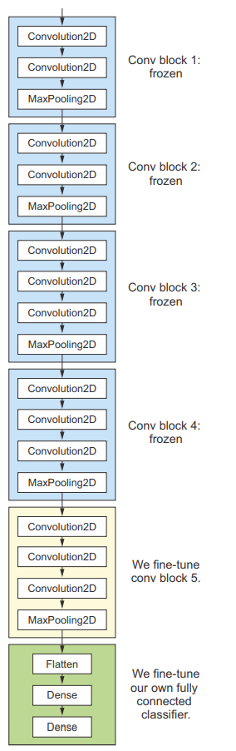
Using Pretrained model (Fine tuning)
Fine-tuning consists of unfreezing a few of the top layers of a frozen model base used for feature extraction, and jointly training both the newly added part of the model (in this case, the fully connected classifier) and these top layers.
Conv Block 1:
Frozen
Conv Block 2:
Frozen
Conv Block 3:
Frozen
Conv Block 4:
Frozen
Fine tune
Conv block 5
Fine tune our fully-connected classifier

Slide 17
Steps for fine tuning
Add custom network on top of an already-trained base network.
Freeze the base network.
Train the part
Unfreeze some layers in the base network.
Jointly train both these layers

Slide 18
Why not fine-tune more layers?
Earlier layers in the convolutional base encode more generic, reusable features,
whereas layers higher up encode more specialized features.
It’s more useful to fine-tune the more specialized features, because these are the ones that need to be repurposed on your new problem. There would be fast-decreasing returns in fine-tuning lower layers.

Slide 19
Freezing all layers until the fourth from the last
Using Pretrained model (Fine tuning)
conv_base.trainable = True
// freeze first four layers
for layer in conv_base.layers[:-4]:
layer.trainable = False

Slide 20
Fine-tuning the model
Using Pretrained model (Fine tuning)
model.compile(loss="binary_crossentropy",
optimizer=keras.optimizers.RMSprop(learning_rate=1e-5),
metrics=["accuracy"])
Start by choosing RMSprop optimizer, with a very low learning rate. The reason for using a low learning rate is that we want to limit the magnitude of the modifications we make to the representations of the three layers we’re fine-tuning. Updates that are too large may harm these representations.

Slide 21
Using Pretrained model Object Detection
YOLO v5
Backbone
extract input image feature
Neck
Head

Slide 22
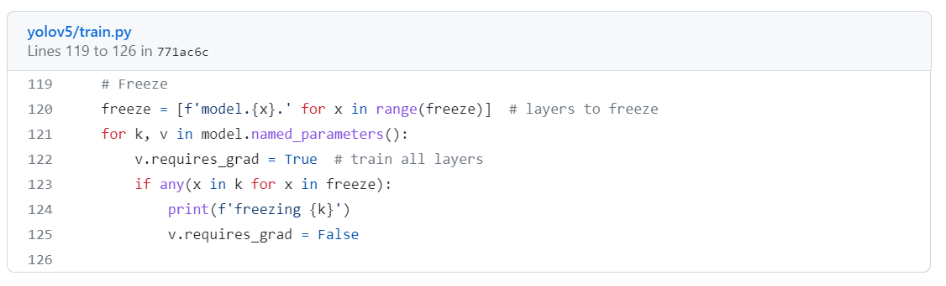
How YOLO implements freezing? What does it mean by freezing a layer?

Slide 23
Check the model structure yolov5/models/yolov5s.yaml
# freezing first 10 layers
Backbone = 10 layers
# freezing 24 layers
Head= 14 layers

Slide 24
Executing Transfer Learning Object detection
1. Freeze the YOLOv5 Backbone
backbone means the layers that extract input image features.
freeze the backbone so the weights in the backbone layers will not change during YOLOv5 transfer learning.
only train the last layers (i.e., head layers)
python yolov5/train.py --data .yaml --weights yolov5s.pt --epochs 100 --batch 4 --freeze 10

Slide 25
Executing Transfer Learning Object detection
Freeze All Layers (backbone+head)
To freeze the full model except for the final output convolution layers in Detect(), we set freeze list
python yolov5/train.py --data .yaml --weights yolov5s.pt --epochs 100 --batch 4 --freeze 24

Slide 26
Executing Transfer Learning Object detection
3. Finetuning (no freezing)
Training all the layers of the small model.
Starting from the official COCO pretrained weights yolov5s.pt
The learning rate parameter can be adjusted at the hyperparameters-configurations file
the entire model will be fine-tuned on the new dataset
python train.py --hyp 'hyp.finetune.yaml' --data ../data.yaml --weights yolov5s.pt \
--img 640 --epochs {EPOCHS} --batch-size 16 --name {RES_DIR}
we are creating a new directory for saving the results. The path for that is saved in the RES_DIR variable. This is important because we want to control where the results are saved. Else, the script will create its own directories as run_1, run_2, and so on, while executing the train.py script.

Slide 27
Deciding a pretrained model for a custom problem
Scenario 1 – Size of the Data set is small while the Data similarity is very high
In this case, since the data similarity is very high, we do not need to retrain the model. All we need to do is to customize and modify the output layers according to our problem statement.

Slide 28
Deciding a pretrained model for a custom problem
Scenario 2 – Size of the data is small as well as data similarity is very low –
In this case we can freeze the initial (let’s say k) layers of the pretrained model and train just the remaining(n-k) layers again.

Slide 29
Deciding a pretrained model for a custom problem
Scenario 3 – Size of the data set is large however the Data similarity is very low –
In this case, since we have a large dataset, our neural network training would be effective. However, since the data we have is very different as compared to the data used for training our pretrained models. The predictions made using pretrained models would not be effective. Hence, its best to train the neural network from scratch according to your data.

Slide 30
Deciding a pretrained model for a custom problem
Scenario 4 – Size of the data is large as well as there is high data similarity –
This is the ideal situation. In this case the pretrained model should be most effective.

Slide 31
Summary
Convnets are the best type of machine learning models for computer vision tasks. It’s possible to train one from scratch even on a very small dataset, with decent results.
On a small dataset, overfitting will be the main issue. Data augmentation is a powerful way to fight overfitting when you’re working with image data.
It’s easy to reuse an existing convnet on a new dataset via feature extraction. This is a valuable technique for working with small image datasets. As a complement to feature extraction, you can use fine-tuning, which adapts to a new problem some of the representations previously learned by an existing model. This pushes performance a bit further.

